Slide 1


COMPANY PROFILE
REVOLVE RESEARCH & CONSULTING GROUP LTD
Chaka Place Suite 7
Argwings Kodhek road
P.O. BOX 2053-00200
Nairobi
info@revolveresearch.co.ke
+254 724 314 551

Slide 2

ABOUT US
Revolve Research and Consulting Group (R²CG) Limited has been operational since 2012 under the trade name ‘beta consulting’. In 2022, it was registered a new as R²CG to expand its scope and attract fresh thinking for research, development and consultancy in Eastern Africa.
R²CG brings you over three decades of research and performance measurement consultancy experience.
Our team is made up of experts, with varied professional training and experience in the broad field of research for development.
We carry out research and provide advisory services and training on a wide range of development issues, including Agriculture, Health, Education, Social development and gender equity, and Sustainable economic development. In all, making markets work for the poor and building resilience are the overarching goals.
R²CG provides organization and project level support in research project design, monitoring and evaluation, survey data collection/management, data analysis and reporting, behavioral experimentation and idea testing.
1
Economics
2
Statistics
3
Agriculture
4
Environmental Studies

Slide 3

Vision
To be a world class research advisory firm for development and pro-poor growth
Vision,
Mission, and
Values
Mission
To conduct high quality scientific research for policy and development by stimulating innovations, facilitating technology transfer, capacity building and institutional development.
Values
Professionalism, Integrity and Neutrality
Do no Harm
Approach
Collaborative and consultative
Creative.
New way of working
Meticulous

Slide 4
We design case specific research approaches and methods: RCTs, Quasi experimental designs, and various participatory methods
Full range of data management and analysis - cleaning, tabulation, analysis and data visualization.
We have extensive experience in thematic coding and analysis for qualitative research and research translation.
We design and develop online data management, analysis systems and Information & Knowledge Management systems.
Through improving access to data and information, we support organizations and programs to drive new ideas and innovation to direct their strategies and initiatives.
Our specialization is in M&E support for organizations that challenge poverty and inequality.
We build skills and confidence of practitioners to use, adapt and improve M&E systems themselves.
Monitoring, Evaluation & Learning
Research, Development and Analysis:
Data, Information and knowledge Management
Training & Capacity Development
Online Survey Programming
Our capacity programs enables people, communities and organizations to strengthen their capabilities to develop, implement and maintain effective delivery of services.
We provide quality online and offline mobile data collection services
Some of the mobile tools we use include; ODK, Survey CTO, Jotforms mobile, Teamscope, and KoboToolBox,
OUR
SERVICES

Slide 5







Areas of Focus
Research Consultancy Services:
#$
Financial Inclusion and Risk Pooling
Resilience Building and measurement
Agricultural research: Food security and development
Health, Nutrition and WASH
Gender inclusion and child protection
Environmental protection and management
Governance, peace building and conflict resolution
Institutional support and capacity building

Slide 6
Strategic core competencies and outcome for society
Information driven decisions
Environmental integrity
Inclusive societies
Food and nutrition secure communities
Market driven economies
Effective private and public institutions
Enhanced Performance
Nascent and Developing institutions
Fragile environments
Food & nutrition insecurity
Limited market access
Gender inequality & exclusive societies
Technology slow & traditional societies
Innovations &
technologies for community development
*Research &
consultancy *Performance measurement
Institutional
capacity development
services
RRCG Context
Our Inputs
Outcomes

Slide 7
Do No Harm policy
We adhere to Do No Harm guidelines and other country specific operational policies in all our assignment.
Privacy
Approvals
We anonymize all data and resulting reports and insights.
All digital data are always password protected while all hard copies remain under lock and key.
All data remain the property of the client and are only used by us to the extent that written permission is granted
Prior to any assignments, they we obtain necessary permissions for ethical, political and logistical reasons. Such permissions are obtained from inter alia;- governments, science and technology departments and some professional research bodies
Our Ethics and Policies
Confidentiality
RRCG maintains the highest standards of data confidentiality. We strictly adhere to the Kenyan data protection act. Our interviewers and data personnel do not discuss respondents’ answers with anyone,. Respondents’ names or other identifying information does not appear on the data set. Where clients request for personal data for purposes of data tracking, we ensure appropriate consent is provided.
Informed consent
During field assessments, our respondents are always enabled to exercise their right to refuse the interviews, or to refuse to answer specific field assessment questions. Informed consent is obtained from all respondents in their local languages prior to their participation in our studies.

Slide 8
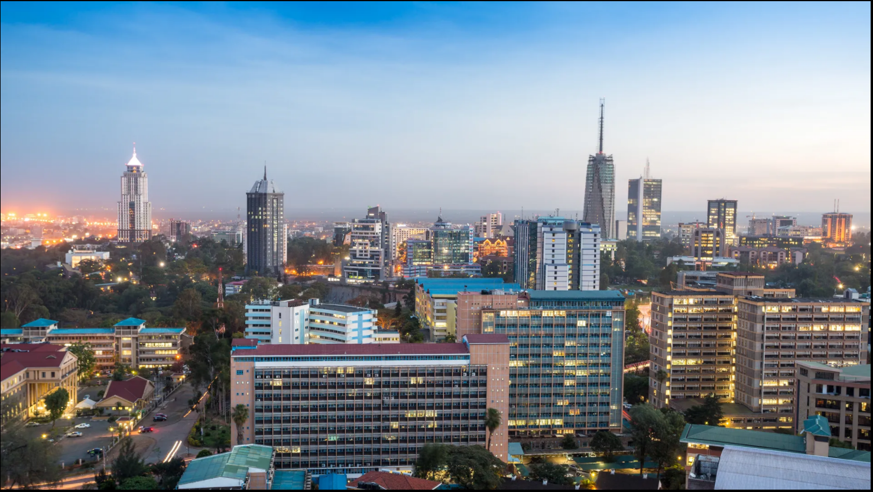
Consultants’ Bio-Data

Slide 9
Title | Managing Director
Name | Jack Odero
General Information | Nationality: Kenyan Gender: Male Languages: English, Kiswahili
Education Level | M.Sc Health Economics and Policy, B.Sc Agricultural Economics
Biodata | Jack is an accomplished Research Economist with a proven experience in managing and leading performance measurement and monitoring initiatives that have informed policy decisions by Multilateral Agencies of both technical and development nature. Jack is recognized as highly adept in designing M&E systems, data management and econometric analysis with key credential of generating highly resourceful project and monitoring reports. Currently an independent consultant for FSD Trust-Kenya and the leading M & E Expert for FAO Somalia’s third-party monitoring activities (through Savana consultancy and research services). Jack has been managing evidence based social and economic research to support Programs of the governments and private sector agencies in the areas of Financing, Agriculture, disaster risk recovery and resilience, Health and Sanitation. Some of his roles in this position have included but have not been limited to the following; Project manager- FSD Trust-Kenya – An audit of digital loan Services and service providers in Kenya and evaluation of their impact on financial inclusion. Independent Consultant research Manager- Mercy Corps-Kenya (AFA project) Performance Measurement Expert- FSD (Financial Sector Deepening trust- Kenya- Financial Access Price Index Project. Third party Monitoring Expert- FAO Somalia- Crop, livestock, Fisheries and cash-based Interventions impact assessments Research economist -International Water Management Institute (IWMI) - Assessing the investment climate for RRR businesses in Kenya (Waste-to-value ventures). Research economist -International Water Management Institute (IWMI) – Nature positive solutions for shifting agri-food systems to more resilient and sustainable pathways

Slide 10
Title | Director –Research and analytics
Name | Timothy Kimaiyo
General Information | Nationality: Kenyan Gender: Male Languages: English, Kiswahili
Education Level | PhD Economics (on going), MA in Economics
Biodata | Timothy has extensive skills in managing and leading research and monitoring and evaluation (M&E) in the field of development economics, governance, and state-building. His competencies include econometrics, quantitative and qualitative analysis as well as proficiency in the use of data statistical software such as STATA and SPSS. He is particularly passionate about exploring the use of evidence-based solutions to influence policy and development. He holds a Master of Arts in Economics and Bachelor of Economics (First Class Honours) both from the University of Nairobi Kenya. Timothy has previously worked at the Busara Center for Behavioral Economics, a research and advisory firm focused on applying Behavioral Science in the global south, and Royal United Services Institute (RUSI) Nairobi where he conducted research, monitoring and evaluation of programmes in situations of fragility, conflict, and violence (FCV).

Slide 11
Title | Projects manager
Name | Nicholas Pacho
General Information | Nationality: Kenyan Gender: Male Languages: English, Kiswahili
Education Level | M. Sc. Knowledge management (ongoing), Bsc. Information Science
Biodata | Nicholas is the Projects manager for Revolve Research Consulting Group based in Kenya. He has a diverse set of interests: impact measurement, M&E, and humanitarianism, and is an enthusiast of humanitarian knowledge management and dissemination. Nicholas has previously supported various assessments in the financial inclusion space with financial sector deepening Kenya trust (FSDK) in their flagship Cost of Banking in Kenya Study project as well as other studies on digital credit conduct and practices in Kenya and New York University’s Small Firm Diaries project. Beyond his work in the financial inclusion space, Nicholas has contributed capacity to humanitarian initiatives, most notably the “Out-of-Camps Shelter assessment in Borno State, Nigeria by IOM and Shelter Centre based in Geneva to assess the housing needs and challenges of internally displaced persons as a result of the armed conflict in Northern Nigeria. Nicholas is currently consulting for ACAPS (Assessment Capacities Project) in Geneva, Switzerland. He continues to consult for other organizations in his area of expertise. Nicholas holds a Bachelor’s degree in Information Science and is on course to complete an M.Sc. Knowledge Management at Kenyatta University, which was also his undergraduate alma mater.

Slide 12
Tasks being handled currently include;
A quasi experimental impact evaluation of the Joint Resilience Action program (JRP) in Somalia. JRP is being implemented by UNICEF, WFP and FAO for three years to 2025.
Third Party monitoring for FAO Somalia, assessing the impacts of both agriculture, livestock and cash based interventions with over 100,000 households.
Nature positive solutions for shifting agri-food systems to more resilient and sustainable pathways in Kenya. Led by International Water Management Institute-IWMI). RRCG has developed a catalogue of waste to value enterprises and is supporting the structuring and formation of an innovation hub to enhance circularity in Kenya
Project
Portfolio
Baseline Survey- Rice Based and Market-Oriented Agriculture Promotion Project (RiceMAPP) (May to September, 2013)
Client- JICA
Lead consultant(s): Timothy Kimaiyo
RRCG was contracted to run the RiceMAPP socio-economic survey of the Mwea Irrigation Scheme. The objectives of this survey were to clarify the agricultural management and economic status of farmers with different rice planting times, and of those farmers operating inside and outside the irrigation scheme. This was aimed at establishing the indicators for future monitoring and evaluation of project activities.
1
2
3
4
Competitive Compost Market Analysis in Kenya and Smallholder farmer profiling in Kiambu, Machakos and Kajiado Counties of
Kenya. (September to December 2014)
Client- Taka Taka Solutions
Lead Consultant(s)- Jack Odero.
E-payments scoping study.
(February-March 2015)
Client- FSD-Kenya
Lead Consultant(s): Jack Odero.
This exercise involved surveying financial institutions to enable
the client understand the rate of electronic payments take up in Kenya and advice policy efforts directed at enhancing a cash light economy.
The firm was contracted to undertake a comprehensive literature review and engage major stakeholders in the Kenyan fertilizer market to give a competitive market analysis of the compost market in Kenya. The objective was to advice the client on Market entry considerations. We also profiled smallholder farmers in three
Counties of Kenya to help the farm understand compost client base.

Slide 13
Project
Portfolio (Page 2)
Baseline Survey - Project, ‘Assessing market response to cash
transfer possibilities in Kenyan ASALs’-(Aug, 2012-Sep, 2012}
Client: World Food Programme (WFP)
Lead consultant: Jack Odero
We were contracted to support this baseline study’s data collection and management exercise. This included designing and testing of data collection tools and databases, recruitment and training of field assistants, supervision of field work, and analysis of the data.
This baseline study was conducted for over a month in Kenya’s arid and semi-arid Northern frontier province, from Isiolo to Moyale, and it mainly involved trader-to-trader, household interviews and focus group discussions.
5
6
7
Project Evaluation and Impact Assessment-Seeds for Development (S4D) Project-South Sudan
(May to June, 2013).
Client: International Fertilizer Development Centre (IFDC)
Lead consultant(s): Jack Odero
Baseline Survey- Project, ‘Measuring and mitigating the risk of Aflatoxins in poor milk and maize producers and consumers’. (May, 2012-July, 2012)
Client: IFPRI/ MTT Agri-Food Research-Food Africa Programme.
Lead consultant: Jack Odero
This exercise involved conducting farmer and agro-dealer interviews in three states of South Sudan, to evaluate the impact of the S4D project’s voucher and agro-dealer development to build towards the
final project report for the USAID. We were tasked with the responsibility of designing survey plans and tools, recruiting, training and supervising local data collection teams, and finally analyzing the data and providing the project’s Chief of Party with a preliminary and final assessment report.
For the duration of this baseline study, we successfully supported the planning of field activities guided the design/revision of data collection tools and databases in MS Excel and SPSS. We also supervised the household and key informant interviews, cleaning and entry of data in the field, data summary, coding and analysis which fed into the preliminary baseline report. The baseline survey was intended to inform a larger project that aimed at evaluating incidence of Aflatoxins in maize and milk, within eastern and central provinces of Kenya, while at the same time assessing possible mitigating interventions.

Slide 14
Project
Portfolio (Page 3)
Socioeconomic study-Ethio- Kenya Power Interconnection Project (Feb 2012-May 2012)
Client: Kenya Electricity Transmission Company Sub-Contracted by Gamma Systems
Lead consultant- Jack Odero
The brief of our assignment was to carry out an extensive socioeconomic study of line counties and towns covered by the proposed power line from Ethiopia to Kenya, specifically focusing on the 612km in the Kenyan side. This was to inform the drawing up of a Reallocation Action Plan (RAP) to compensate households along the power line’s Right of Way (RoW). Our mandate was to carry out a desk review of socioeconomic and demographic indicators along the RoW and follow it up with a field data collection to verify secondary data collected in the desk study.
8
9
Project Management-‘Mitigation of Food Safety Risk in Leafy Vegetables Supply Chain in Nairobi’-A project of the Swedish University of Agriculture. (Oct 2012-May 2013).
Lead Consultant: Jack Odero
With the principal investigators in Sweden and the project based in
Kenya, we managed local operations of the project that entailed
training, recruitment and supervision of data enumerators, supervising data collection from green vegetable markets in Nairobi and we also carried out a field experiment using the ZMET techniques to elicit consumers perceptions on food safety risks and a market auction process to determine willingness to pay for clean vegetables. We organized a workshop as well on 5-12-12 for stakeholders in the vegetables value chain in Nairobi to present preliminary findings.

Slide 15
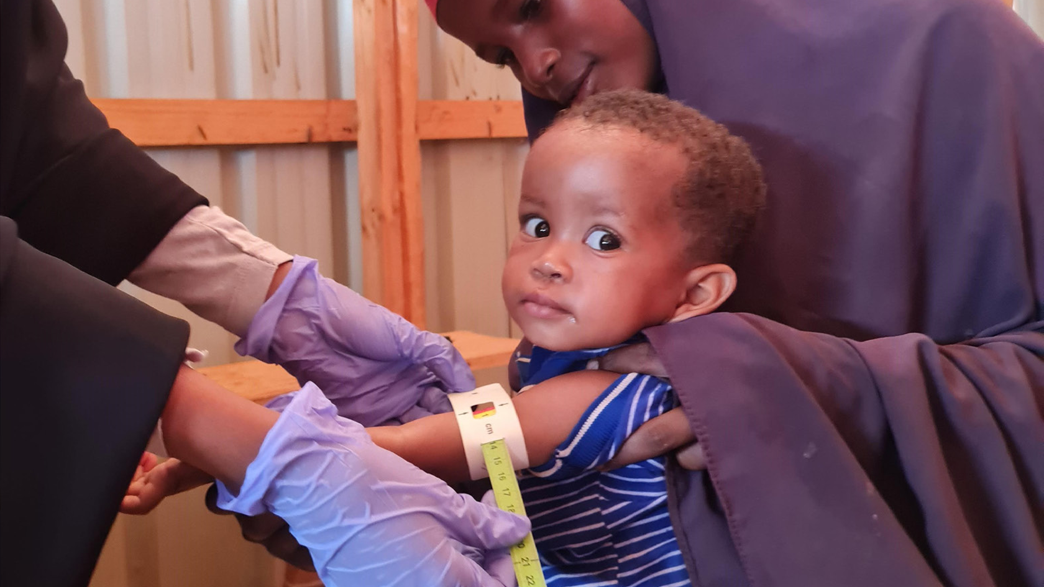
CONSULTING PARTNERS
Jack Odero
Jack.odero@revolveresearch.co.ke
Timothy Kimaiyo
Tim.kimaiyo@ revolveresearch.co.ke
Nicholas Pacho
Nick.pacho@ revolveresearch.co.ke

